Slide 1
t-tests
Learning Centre

Slide 2
Content
1
T-test
2
Types of t-tests
3
SPSS examples
4
Reporting
What is a t-test?
Spoiler alert: There are 3!
How to run t-tests on SPSS
How to report results from SPSS output

Slide 3
What is a t-test?
A statistical analysis that tells us whether the difference between 2 groups happened by chance
Measured using mean scores of the 2 groups, standard deviations, and a number of data points
(but SPSS does the calculations for us!)
Annotated by t statistics, which can be positive or negative

Slide 4
Types of t-tests
1
3
Between subjects t-test
One sample t-test
Within subjects t-test
2

Slide 5
1. One Sample t-test
A one sample t-test is used if we want to know whether a sample mean is different from a known population mean

Slide 6
Example
In my statistics class of 20 young adults, we could see that we were all quite tall. We then thought to ourselves: “Hmm, are we really taller than the average population?”
We then searched the Internet for census data on the height of young adults in Singapore, and at the same time measured the height of everyone in my class.
Are we really taller?

Slide 7
Location of SPSS Data Files
Example SPSS data for practice are available on LearnJCU:
Log in to LearnJCU -> Organisations -> Learning Centre JCU Singapore ->
Learning Centre -> Statistics and Maths -> SPSS Data for Practice

Slide 8
Assumptions Testing…
Before conducting the t-test, we need to first make sure that our data is normally distributed (assumption of normality)...

Slide 9
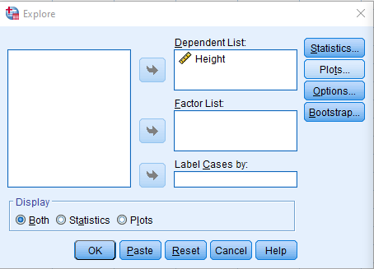
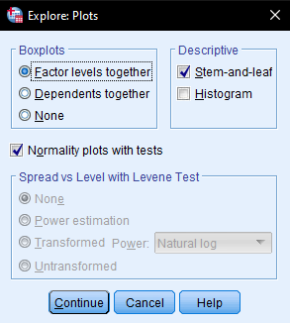
Assumptions Testing…
Analyze -> Explore
Move ‘Height’ to Dependent List
Click on Plots, select ‘Normality plots with tests’
Continue, and OK

Slide 10
Assumptions Testing…
Since the Shapiro-Wilk p value is > .05, we conclude that assumption of normality is not violated

Slide 11
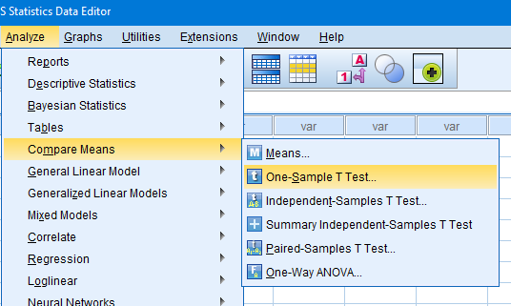
Onto SPSS!
Analyze -> Compare Means -> One-Sample T Test

Slide 12
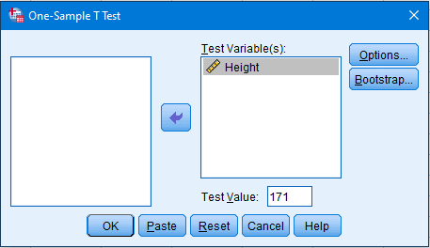
Onto SPSS!
Move ‘Height’ as the Test Variable
Enter the ‘Test Value’, which is the census data we found on the Internet (171 cm.)
OK!

Slide 13
Onto SPSS!
This is our degrees of freedom, which is calculated by n-1 (20 people in my class minus 1 = 19)
We get a t score of -.639. A negative t score in this case suggests that we are NOT taller than the known population mean, but is this statistically significant?
p value is .53. Since this is greater than our alpha value of .5, we say that we fail to reject the null hypothesis. In other words, there is no difference between how tall we are, and the population
Notes:
Maybe add why fail to reject null hypothesis, rather than accepting it: https://statisticsbyjim.com/hypothesis-testing/failing-reject-null-hypothesis/

Slide 14
Write-up
An example write-up is available on:
JCUS Learning Centre website -> Statistics and Mathematics Support

Slide 15
Types of t-tests
1
3
Between subjects t-test
One sample t-test
Within subjects t-test
2

Slide 16
2. Between Subjects t-test
Also known as independent samples t-test, it is used to compare groups which are not related (i.e., independent)

Slide 17
Example
A researcher wanted to find out if there is a difference in time spent on social media between males and females. She hypothesised that females spend more time a day on social media, compared to males. The researcher collected data from 25 males and 25 females
Do females spend more time in a day on social media compared to males?

Slide 18
Assumptions Testing…
Before conducting the t-test, we need to first test the assumption of normality

Slide 19
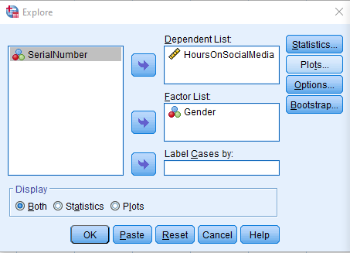
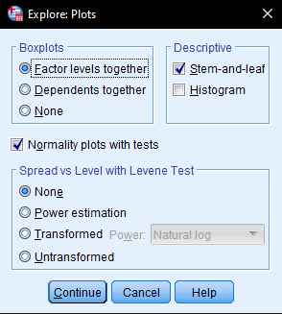
Assumptions Testing…
Analyze -> Explore
Move ‘HoursOnSocialMedia’ to Dependent List, and ‘Gender’ to Factor List
Click on Plots, select ‘Normality plots with tests’
Continue, and OK

Slide 20
Assumptions Testing…
Since the Shapiro-Wilk p values are both > .05, we conclude that assumption of normality is not violated

Slide 21
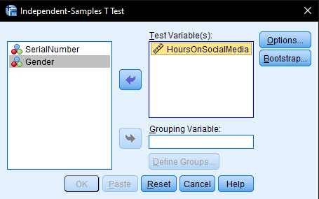
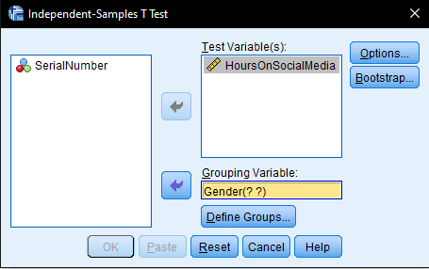
Onto SPSS!
Analyze -> Compare Means -> Independent Samples T Test
Move ‘HoursOnSocialMedia’ to the right column as the Test Variable
Select ‘Gender’ as the Grouping Variable

Slide 22
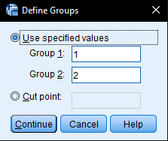
Onto SPSS!
Click on Define Groups
Since female is coded as ‘1’, and male as ‘2’, type in ‘1’ and ‘2’ under groups 1 and 2, respectively (you can switch them around if you wish)
Click continue, and OK!

Slide 23
Onto SPSS!
This is to evaluate if the variances between 2 groups were significantly different from each other (Assumption test for homogeneity of Variance)
p-value was .378, which is larger than .05, indicating assumed equality of variances. Hence we focus on this row
t value = 8.12, df = 48, and p value <.001.
This means there was a significant difference on social media usage in a day between males and females
Females spent more time on social media per day compared to males (almost double the time!)

Slide 24
Write-up
An example write-up is available on:
JCUS Learning Centre website -> Statistics and Mathematics Support

Slide 25
Types of t-tests
1
3
Between subjects t -test
One sample t-test
Within subjects t-test
2

Slide 26
3. Within Subjects t-test
Also known as paired samples t-test, it is used to compare groups which are related (e.g., same person; before and after a treatment)

Slide 27
Example
A number of students failed their statistics module last semester. To help them, the Learning Advisors invited these students to attend remedial classes throughout the current semester.
To evaluate the effectiveness of the classes, the learning advisors analysed the overall grades of all students who attended the lessons, and compared them to their grades during the last semester.
Did the remedial classes improve students’ grades?

Slide 28
Assumptions Testing…
Before conducting the t-test, we need to first test the assumption of normality for 3 variables: pre-remedial, post-remedial, and also the difference score between the 2 variables
To calculate the difference, we use the Compute Variable function

Slide 29
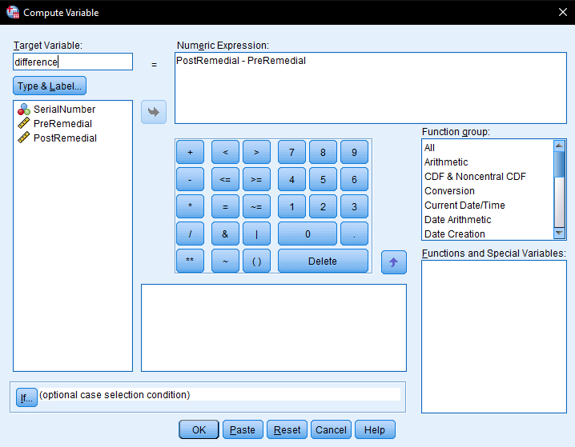
Assumptions Testing…
Transform -> Compute Variable
Enter ‘difference’ as Target Variable
Select ‘PostRemedial’ and move it to Numeric Expression
Click the minus (-) in the numpad
Select ‘PreRemedial’ and move it to Numeric Expression
We are basically calculating the difference of before and after scores
OK

Slide 30
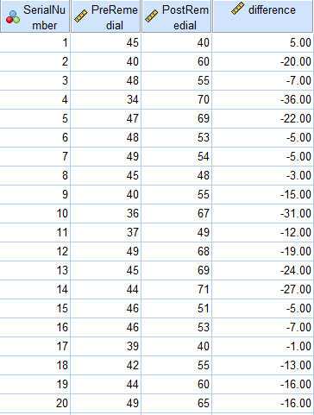
Assumptions Testing…
SPSS will create a new column

Slide 31
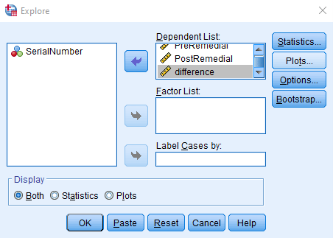
Assumptions Testing…
To conduct the normality tests:
Analyze -> Explore
Move ‘PreRemedial’, ‘PostRemedial’, and ‘difference’ to Dependent List
Click on Plots, select ‘Normality plots with tests’
Continue, and OK

Slide 32
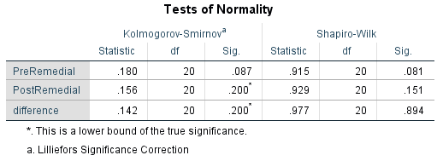
Assumptions Testing…
Since the Shapiro-Wilk p values are all > .05, we conclude that assumption of normality is not violated

Slide 33
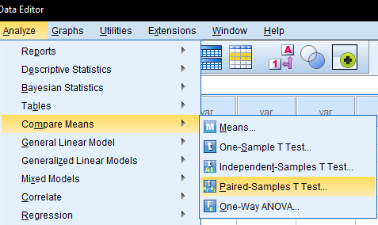
Onto SPSS!
Analyze -> Compare Means -> Paired-Samples T Test

Slide 34
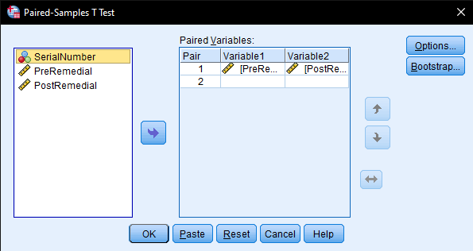
Onto SPSS!
Select both ‘PreRemedial’ and ‘PostRemedial’ and move them over to the right column (you can hold the ctrl key to select multiple variables)
OK!

Slide 35
Onto SPSS!
Looking at the output file, we get a t score = -5.834.
This is the degrees of freedom (n - number of pairs = 19)
p-value < .001 (smaller than the critical alpha .05). We reject the null hypothesis. Therefore, we conclude that scores before and after remedial lessons were significantly different.
We can say that, on average, students who underwent remedial classes improved their grades from 43.65 to 57.60 (check p value for statistical significance)

Slide 36
Write-up
An example write-up can be found on:
JCUS Learning Centre website -> Statistics and Mathematics Support

Slide 37
Questions? learningcentre-singapore@jcu.edu.au

