Slide 1
MANOVA
Learning Centre

Slide 2
Table of Contents
01
02
03
What is MANOVA
Types of MANOVAs
Worked Example

Slide 3
Multivariate Analysis of Variance (MANOVA)
The Multivariate Analysis of Variance (MANOVA) is an extension of the ANOVA
While we only deal with ONE DV in ANOVA, MANOVA accounts for multiple DVs at once
It wants to know if there are mean differences across groups on multiple DVs; it is suitable to test related DVs – e.g., testing depression, anxiety, and stress across groups at one go

Slide 4
Types of MANOVAs
Similar to ANOVAs, there are between and within subjects MANOVAs
If there is one IV, we call it a one-way between/within subjects MANOVA; if there are two IVs, we call it a two-way between/within MANOVA
A test that mixes both between AND within IVs is called mixed MANOVA
We will focus on ‘one-way MANOVA’ in the next slides!

Slide 5
Example: One-Way Between-Subject MANOVA
I am interested in finding out if coffee consumption affects anxiety and fatigue levels.
To test this, I shall recruit 100 participants and randomly assign them into 2 groups: an experimental group who will drink a cup of coffee, and a control group who will drink a cup of water.
I will then ask each participant to rate their level of anxiety
and fatigue.
Dr Tony Lim
World Class Researcher

Slide 6
Example: One-Way Between-Subject MANOVA
In this example, we have 1 IV with 2 levels: Coffee vs. Water
We have 2 DVs: Anxiety, Fatigue
Thus, it is appropriate to conduct a one-way between subjects MANOVA

Slide 7
Location of SPSS Data Files
Example SPSS data for practice are available on LearnJCU:
Log in to LearnJCU -> Organisations -> Learning Centre JCU Singapore ->
Learning Centre -> Statistics and Maths -> SPSS Data for Practice

Slide 8
Assumptions Testing
Normality (Shapiro Wilk)
Univariate Outliers (Boxplots)
Multivariate Outliers (Mahalanobis Distances)
Multicollinearity (Correlation)
Linearity (Scatterplot)
Homogeneity of variance-covariance matrices (Box’s M)
*You can meet other criteria before/during data collection, such as independence of observations (each participant can only take part in the study once), and ensuring adequate sample size in each cell (through a power analysis)

Slide 9
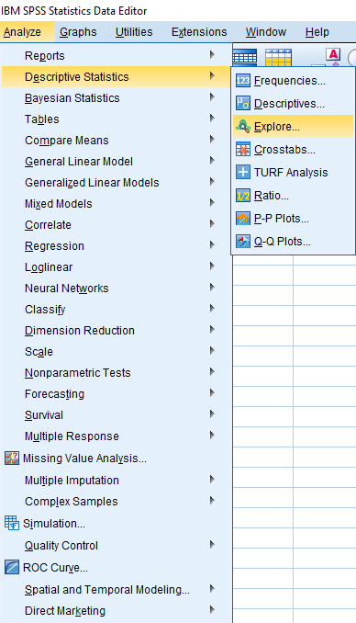
1. Normality
Go Analyze -> Descriptive Statistics -> Explore

Slide 10
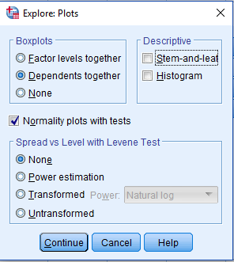
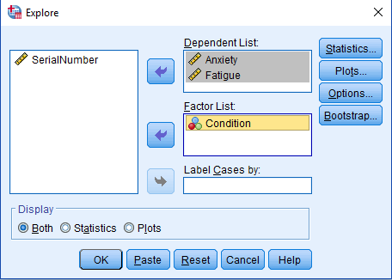
1. Normality
Move ‘Anxiety’ and ‘Fatigue’ to the Dependent List, and ‘Condition’ to the Factor List
Tick ‘Normality plots with tests
Continue and OK

Slide 11
1. Normality
Looking at Shapiro-Wilk tests, anxiety data in the one-cup water condition were not normally distributed, p = .014.
However, MANOVA is generally robust to a moderate violation of normality,
we will continue to do the analysis for now.

Slide 12
2. Univariate Outliers
The assumption of univariate outliers can be tested via inspecting boxplots
Go Analyze -> Descriptive Statistics -> Explore

Slide 13
2. Univariate Outliers
Move ‘Anxiety’ and ‘Fatigue’ to the Dependent List, and ‘Condition’ to the Factor List
Under Plots, select ‘Dependents together’
Continue and OK

Slide 14
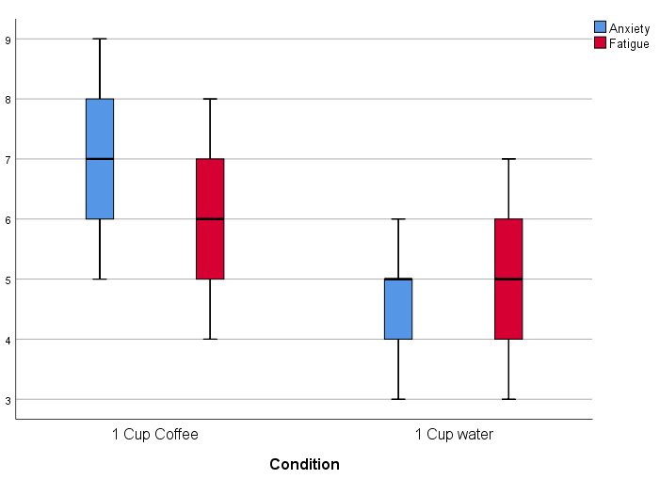
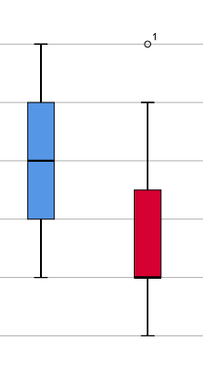
2. Univariate Outliers
Looking at boxplots on the right, we can assume that there are no univariate outliers.
An example of an outlier (if there was one)

Slide 15
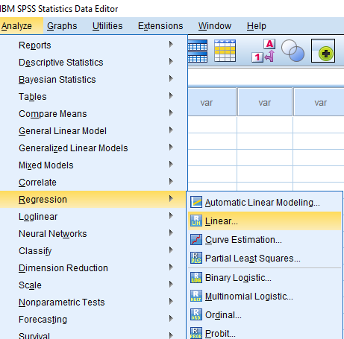
3. Multivariate Outliers
This assumption can be tested via the Mahalanobis Distances
Analyze -> Regression -> Linear

Slide 16
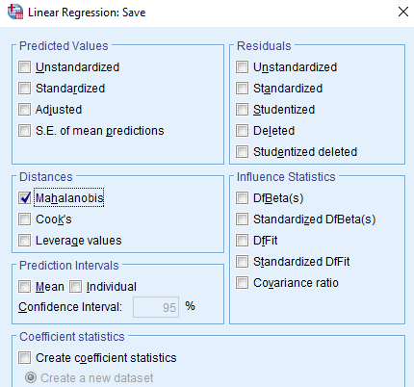
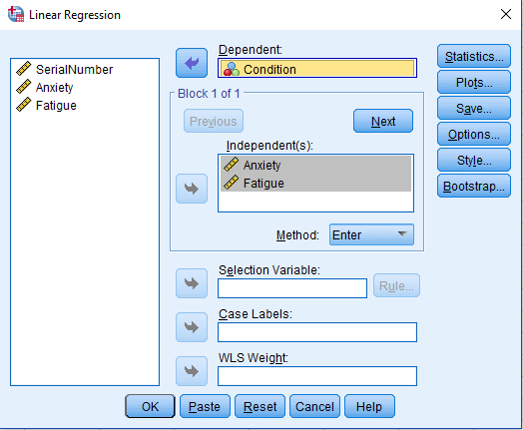
3. Multivariate Outliers
Move ‘Anxiety’ and ‘Fatigue’ to the Independent(s) box, and ‘Condition’ to the Dependent box
In Save, under Distances, select ‘Mahalanobis’, continue

Slide 17
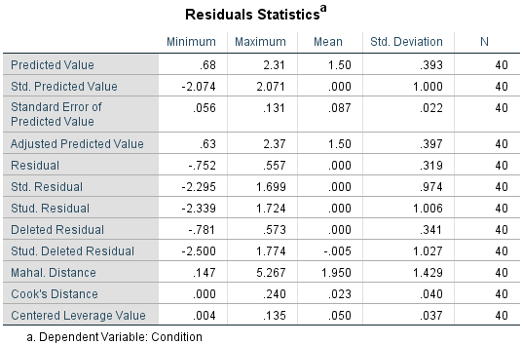
3. Multivariate Outliers
Under Residuals Statistics, Maximum Malal. Distance = 5.267
This value is smaller than the chi-square value at df = 2, α = .05, which is 5.991
*Refer to a the critical value in the Chi-Square table; df = number of DVs
This indicates no multivariate outlier

Slide 18
4. Multicollinearity
The assumption of multicollinearity can be checked via a correlation analysis
Go to Analyze -> Correlate -> Bivariate
*Check out how to run correlation analysis in the Correlation slides (JCUS Learning Centre website -> Statistics and Mathematics Support)

Slide 19
4. Multicollinearity
In the Correlations table, two DVs are slightly correlated but not too strong, r = .172 (less than .7)
Therefore, no violation of multicollinearity

Slide 20
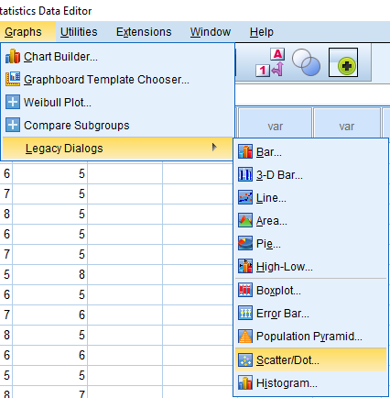
5. Linearity
This assumption can be tested using scatterplots
Graphs -> Legacy Dialogs -> Scatter/Dot -> Simple Scatter -> Define

Slide 21
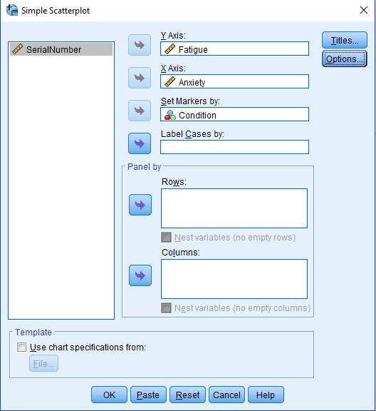
5. Linearity
Go Graphs -> Legacy Dialogs -> Scatter/Dot -> Simple Scatter -> Define
Move ‘Fatigue’ as the Y axis, ‘Anxiety’ as the X axis, and Set Markers By: ‘Condition’
OK!

Slide 22
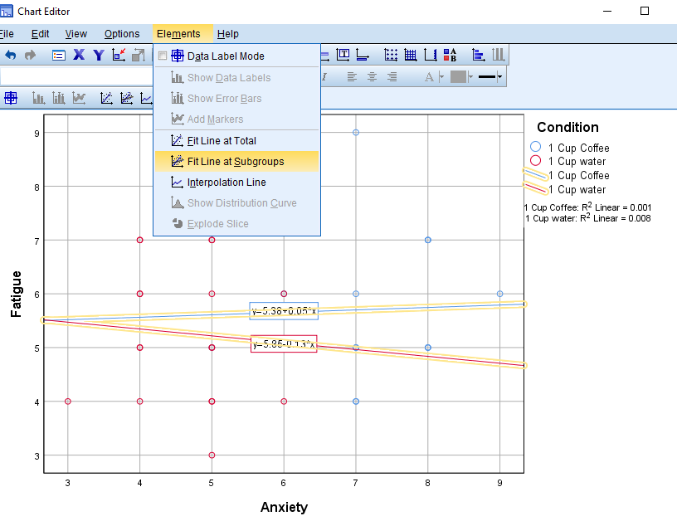
5. Linearity
On the output file, double click the scatterplot to open the chart editor
Click on Elements -> Fit Line at Subgroups
Ensure that ‘Linear’ is selected as the Fit Method
If the lines are roughly straight, we conclude that the assumption of linearity is satisfied

Slide 23
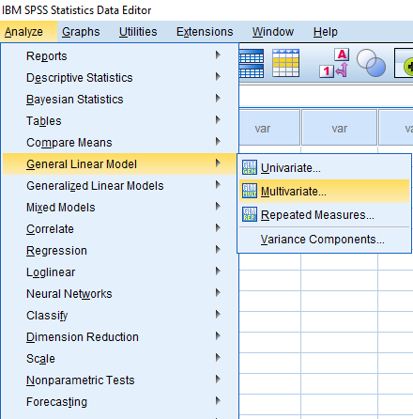
6. Homogeneity of variance-covariance matrices
Analyze -> General Linear Model -> Multivariate
*MANOVA is also conducted using these steps

Slide 24
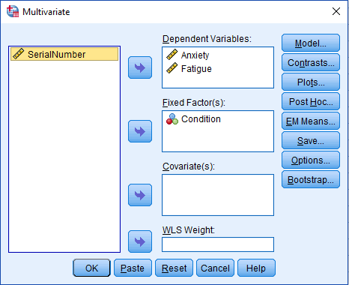
6. Homogeneity of variance-covariance matrices
Move ‘Anxiety’ and ‘Fatigue’ to Dependent Variables
Move ‘Condition’ to Fixed Factor(s)

Slide 25
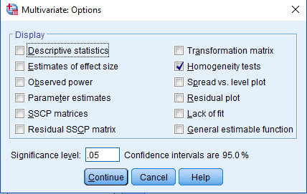
6. Homogeneity of variance-covariance matrices
Under Options, select Homogeneity tests
Continue, and OK

Slide 26
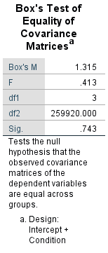
6. Homogeneity of variance-covariance matrices
In order to satisfy this assumption, the Box’s M value should be non-significant at α = .001
A significant value of .743 indicates that the assumption has not been violated

Slide 27
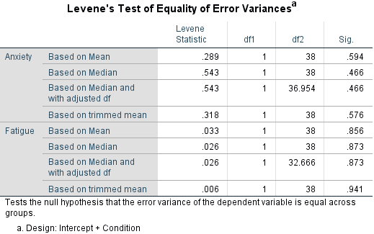
6. Homogeneity of variance-covariance matrices
Output shows Levene’s Test of Equality of Error Variances, where a non-significant Levene Statistic at α = .05 would indicate equality of variances

Slide 28
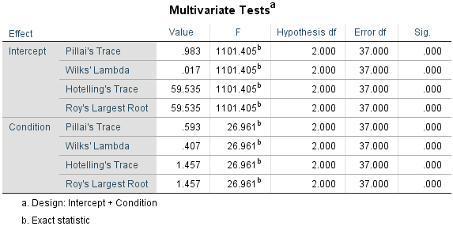
Finally… MANOVA
How to choose the multivariate test?
*Look at how to conduct MANOVA in Slide 22
Multivariate Test | Robustness
 | Sample Size | Levels of IVs | Uneven Cell Sizes | Unequal variance | Non-normal Data | Collinearity
Pillai’s Trace | Small | > 2 | Y | Y | Y | Low to medium
Wilk’s Lambda | Medium to large | > 2 | N | N | N | Low to medium
Hotelling’s Trace | Medium to large | = 2 | N | N | N | Low to medium
Roy’s Largest Root | Medium to large | > 2 | N | N | N | Medium to high

Slide 29
MANOVA
Looking at Pillai’s Trace, F(2,37) = 26.96, p < .001.
There is a statistically significant difference in anxiety and fatigue across types of drinks.

Slide 30
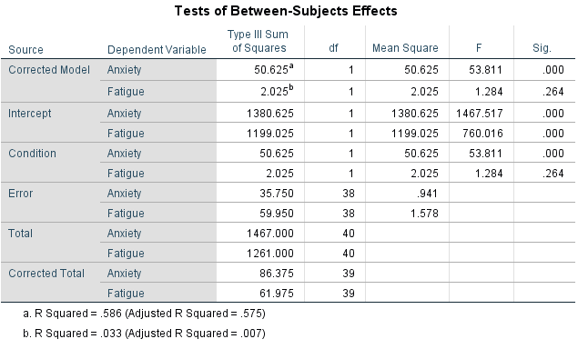
MANOVA
To investigate the effects of each DV, look at the Tests of Between-Subjects Effects table
There is a main effect of drinks (coffee or water) on anxiety, p < .001, but not fatigue, p = .264

Slide 31
Something to note…
This example only contained 1 IV with 2 levels
If we had 3 levels (e.g., 1 cup coffee, 3 cups coffee, 1 cup water), we would have needed to conduct a pairwise comparison test to investigate
which level of the IV significantly affected the DV?
This can be done by going to
-> Analyse -> General linear model -> Multivariate -> Post-Hoc -> Moving the IV to ‘Post Hoc Tests for:’ -> Selecting a preferred post hoc test (common test is Tukey)

Slide 32
Results Write-up
An example write-up can be found on page 167 in
Allen, P., Bennett, K., & Heritage, B. (2019). SPSS Statistics: A Practical Guide (4th ed.). Cengage Learning.

Slide 33
Any Questions? learningcentre-singapore@jcu.edu.au

