Slide 1
Mediation
Learning Centre

Slide 2
Content
1
What is mediation?
2
Types of mediation models
3
SPSS example using PROCESS Macro

Slide 3
What is mediation?
Mediation occurs when a variable (MV) explains the relationship between an independent variable (IV) and a dependent variable (DV)
In other words, the IV affects the MV, which in turn influences the DV
For example, paying a higher salary (IV) leads to increased productivity (DV). However, upon further inspection, it was proposed that higher salary leads to higher morale, which then increases productivity.
MV
IV
DV

Slide 4
What is mediation?
Typically, there are 5 key terms in mediation:
1) Path a – relationship between IV and MV
2) Path b – relationship between MV and DV while controlling for IV
3) Path c – relationship between IV and DV (also known as total effect)
4) Path c’ – relationship between IV and DV while controlling for MV (direct effect)
5) Mediational effect – path a x path b (indirect effect)
MV
a
b
c’
IV
DV
c

Slide 5
Mediational Designs
The mediational model shown in the previous slide is a single mediation design
Other possible designs include multiple mediators, or sequential mediators
Note that each design can have multiple paths a, b , c’, but only 1 total effect (c)
MV 1
MV 1
MV 2
IV
DV
MV 2
IV
DV
MV 3

Slide 6
Example
A company found that paying their employees better were associated with higher productivity. However, a manager pointed out that this could be due to the fact that better wages led to higher morale, which then led to higher productivity. In other words, do employees’ morale mediate the relationship between salary and productivity?

Slide 7
Location of SPSS Data Files
Example SPSS data for practice are available on LearnJCU:
Log in to LearnJCU -> Organisations -> Learning Centre JCU Singapore ->
Learning Centre -> Statistics and Maths -> SPSS Data for Practice

Slide 8
Example
This is what the conceptual diagram of the proposed mediation model looks like…
Morale
Salary
Productivity

Slide 9
PROCESS Macro on SPSS
We will be using the PROCESS macro (by Andrew Hayes) on SPSS to analyse the data
PROCESS can be downloaded from https://www.processmacro.org/download.html
Instructions on installation can also be found in the downloaded file, or on LearnJCU: Log in to LearnJCU -> Organisations -> Learning Centre JCU Singapore -> Learning Centre -> Statistics and Maths -> PROCESS macro installation

Slide 10
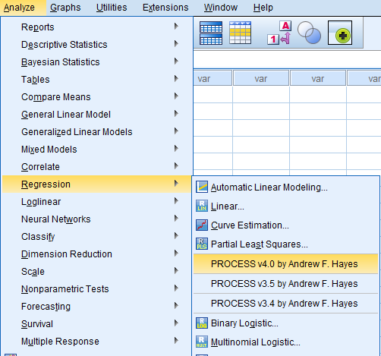
PROCESS Macro on SPSS
Once installed, the macro can be found by going to…
Analyze -> Regression -> PROCESS v4.0 by Andrew F. Hayes
Note that you should only have the latest version installed (v4.0 in this case) if this is your first time installing

Slide 11
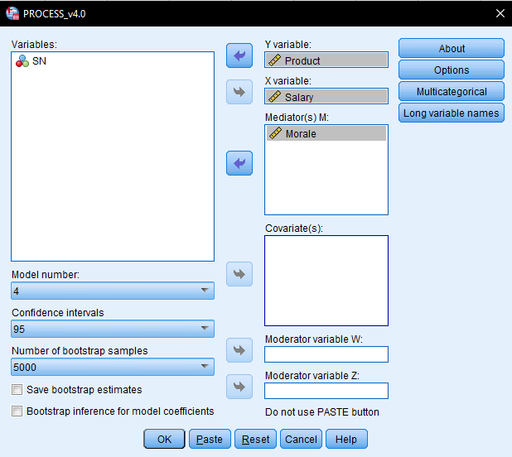
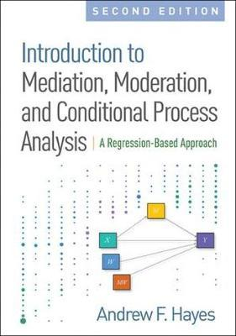
PROCESS Macro on SPSS
Select ‘Salary’ as X variable, ‘Product’ as Y variable, and ‘Morale’ as mediating variable
Change model number to 4 (this is the model for single mediator)
The templates for the model numbers are available in Appendix A of the Hayes’ text
Notes:
*Unsure if showing the templates for different models are against copyright rules?

Slide 12
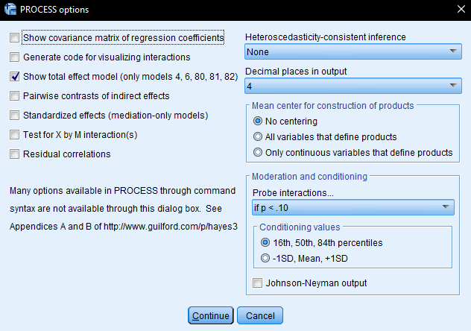
PROCESS Macro on SPSS
Under options, select ‘Show total effects model’
Continue, and OK

Slide 13
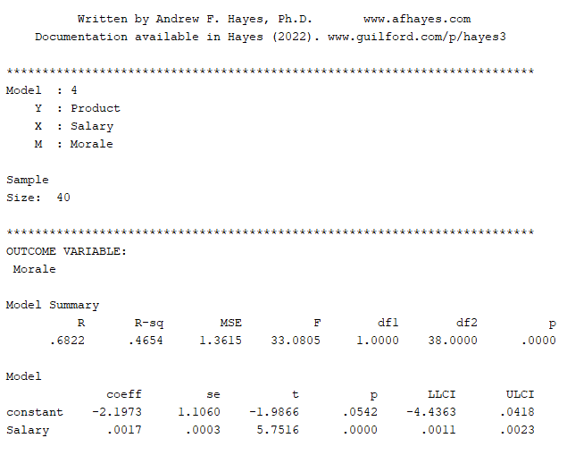
PROCESS Macro on SPSS
The model is significant, R² = .47, F (1, 38) = 33.08, p < .001
In this model, Salary is the predictor and Morale is the criterion (‘Outcome Variable’), also known as path a.
Salary is a significant predictor of Morale, p < .001
Summary of the model number and variables. Note that the sample size used is solely for illustration purposes

Slide 14
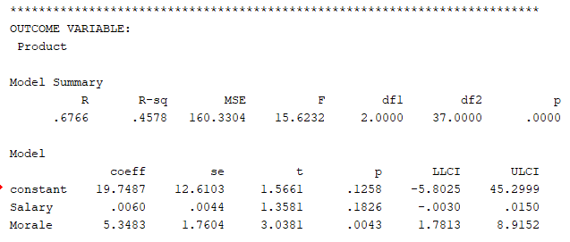
PROCESS Macro on SPSS
Salary is not a significant predictor of Productivity when controlling for Morale, B = .006, p = .18 (this is path c’)
When the effect of morale is accounted for, salary no longer predicts productivity (as compared to path a in previous slide).
This suggests that morale is a mediator of the relationship between salary and productivity
Note that in the next part of the output, the outcome variable is now ‘Product’
Shows the model summary, R² = .46, F (2, 37) = 15.62, p < .001
Morale predicts productivity even after controlling for salary, B = 5.35, p = .004. This is path b

Slide 15
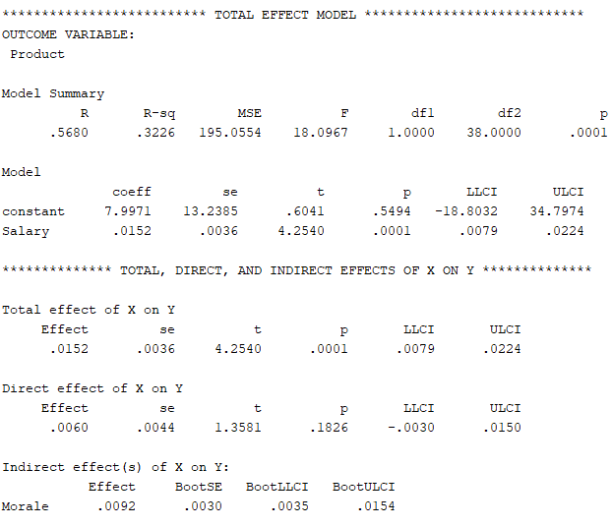
PROCESS Macro on SPSS
Note that outcome variable is still productivity
Model summary, R² = .32, F (1, 38) = 18.10, p < .001
Salary is positively associated with productivity, B = .02, p < .001 (this is path c)
The indirect effect (path a x path b) is .009, and the 95% confidence interval is between .0035 to .0154
If the confidence interval excludes 0, we say that the MV mediates the IV-DV relationship
This is also the primary way to telling if mediation occurs
Note that values of total effect (path c) is the same as shown above (Total effect model)
Values of direct effect (path c’) is also is the same as shown in the previous slide

Slide 16
Statistical Diagram of Example
Based on the analysis, this is how our single mediation statistical diagram looks like..
Morale
.002**
5.35*
.006
Salary
Productivity
.02**
* p < .05, ** p < .001

Slide 17
Write-up
An example write-up can be found on page 213 in
Allen, P., Bennett, K., & Heritage, B. (2019). SPSS Statistics: A Practical Guide (4th ed.). Cengage Learning.

Slide 18
Questions? learningcentre-singapore@jcu.edu.au

